Slide 1
Basic Events
Tutorial #4

Slide 2
OBJECTIVE

Slide 3
Objective
This tutorial demonstrates the most direct sequencing (order of execution) of an event driven program.

Slide 4
TEXTPLANATION

Slide 5
Textplanation
In order to understand what it is you’re doing today, you first need to know what an event is and what it means to say that a computer program is event driven.

Slide 6
Textplanation
An event is basically anything that happens. When you wake up in the morning, that’s an event. When you eat breakfast, that’s an event. When you show up for your first class on time, that’s a major event. People can respond to events in automatic ways, ways that are practiced, and ways that are spontaneous. Your web page can also respond to events, but you have to program them to do so.

Slide 7
Textplanation
An event driven program is one that waits for an event to happen. Once that event is triggered, the computer responds, kicking off a sequence of execution. Web pages are event driven. In fact, graphical operating systems are event driven. They respond to key presses and mouse clicks and all kinds of other digital stimuli. Coding a basic event into a web page is pretty easy. In fact, you’ve already done it.

Slide 8
CONSTRUCTION

Slide 9
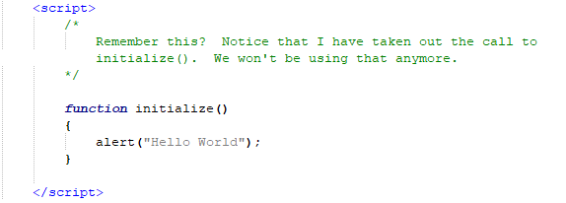
Construction

Slide 10

Construction

Slide 11
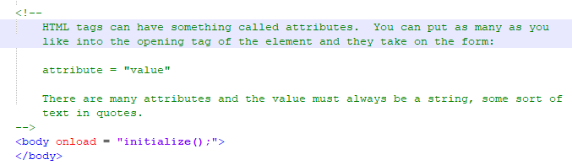
Construction

Slide 12
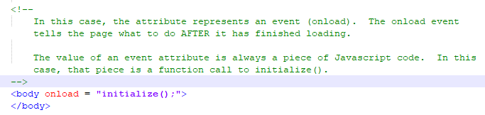
Construction

Slide 13
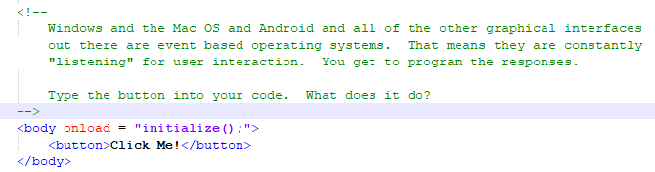
Construction

Slide 14
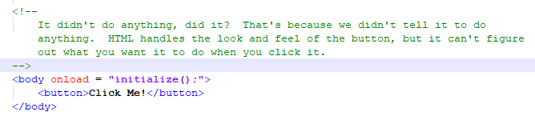
Construction

Slide 15
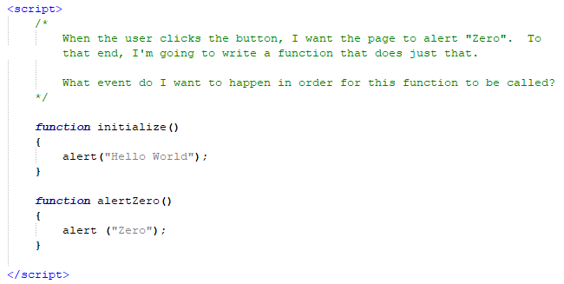
Construction

Slide 16
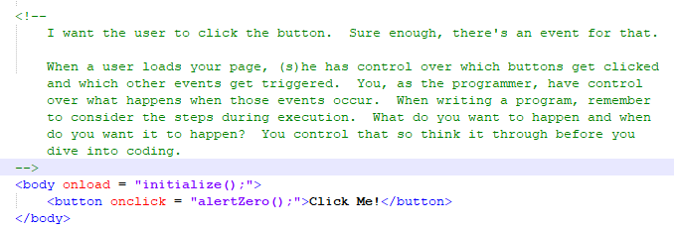
Construction

Slide 17
Construction
Create a folder somewhere on your drive and label it Basic Events.
Open up notepad++.
Save the empty file to your folder and name the file “index.html”.
All first pages on a website are called index.
As you go through the images of the construction, add to your code. You will see comments with explanations of what you are doing. Those comments will change with each slide. You should not type my comments into your code.

Slide 18
A DEEPER MEANING

Slide 19

A Deeper Meaning
Karel the Robot was a brilliant invention used to teach students how to write procedures or functions.

Slide 20
A Deeper Meaning
All Karel did was run around a maze picking up and putting down “beepers”. He had only 4 actions.
Move Forward
Turn Left
PickBeep
PutBeep
What’s missing?

Slide 21
A Deeper Meaning
The designers gave programmers the ability to teach Karel how to do new things by using language he already understood.
How can we teach Karel to turn right?
TurnRight
{
TurnLeft;
TurnLeft;
TurnLeft;
}

Slide 22
A Deeper Meaning
Functions allow us to reuse code without having to rewrite it.

Slide 23
A Deeper Meaning
Objects
are virtual entities that can be altered and manipulated dynamically throughout the course of a program.

Slide 24
FAQ

Slide 25
FAQ
Does an event attribute have to call a function?
No. You can put any Javascript code, and as many statements as you like, as the value of the event attribute. Calling a function, however, streamlines the code. Having line after line of Javascript in quotes in an HTML tag can make your code somewhat...unruly.

Slide 26
ACTIVITY

Slide 27
Countdown
Using the program from the Construction portion of this tutorial, add in 10 more buttons, from one through ten.
Now add a function for each. Each function will alert the number, as we did with functionZero(), however they will each also call the function that comes numerically before it so that the alerts will count down to 0.
When the user clicks on any of the buttons, it will trigger the corresponding function.

